Slide 1
Time series classification with convolutional neural network
Anthony van der Wal | UWA Data Analytics
Project 3 | 27 Feb 2021

Slide 2
Motivation
“… there seems to be something non-algorithmic about our conscious thinking. In particular, … that, at least in mathematics, conscious contemplation can sometimes enable one to ascertain the truth of a statement in a way that no algorithm could.”
― Roger Penrose, The Emperor's New Mind: Concerning Computers, Minds, and the Laws of Physics
In the early 1990’s I attended a lecture by Roger Penrose. He argued that human intelligence cannot be replicated by a Turing Machine. I want to improve my understanding of what currently qualifies as ‘artificial intelligence’.
Gain a functional understanding of image and time series classification tools.

Slide 3


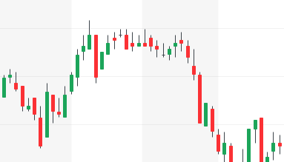
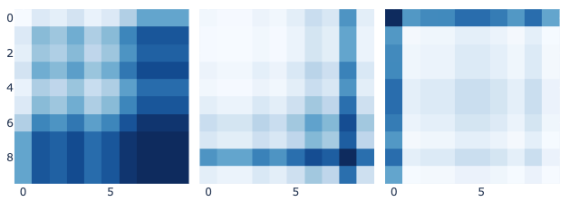
Outline
Objective: classify simple patterns in time series data.
Method:
Time series from currency exchange prices.
1D time series labelled (pos., neg., neut.)
Transform into 2D images.
Train labelled images with Convolutional Neural Network (CNN).
Result: model is used to classify (predict) unlabelled time series.

Slide 4
Sources
EUR-USD hourly exchange rates.
Gramian angular summation field:
Wang & Oates (2015) -- https://arxiv.org/abs/1506.00327
Training:
Kaggle -- https://www.kaggle.com/imetomi/eur-usd-forex-pair-historical-data-2002-2019
Prediction
Yahoo Finance -- https://pypi.org/project/yfinance/

Slide 5
Functional understanding
Split data consecutively – images are created from groups of 10 consecutive datapoints.
GASF – 2D images that retain the angular relationships of a 1D series.
CNN – computationally efficient. Accurate. Modelled after mammal eyesight.
Conv2D – extract features from images. Filters are trained on coarse shapes at first – subsequent convolutional layers will look for finer features. Each filter identifies a feature. Output ’convolved’ feature maps. Feature maps are smaller than the input image.
MaxPooling – partition convolved feature maps. Retain only the maximum value of each partition. Pooled feature maps are smaller than the convolved feature maps. The max pooling retains only the prominent features.
Flatten – transform the 2D images into a 1D series easily consumed by a neural network.
Dense (fully connected) – create additional attributes of the feature maps. Run them forward/backward to adjust the weights.
Dropout – randomly set feature values to 0. Helps reduce overfitting by preventing adjacent nodes being ‘influenced’ by each-other.
https://www.cs.ryerson.ca/~aharley/vis/conv/flat.html
https://towardsdatascience.com/wtf-is-image-classification-8e78a8235acb

Slide 6
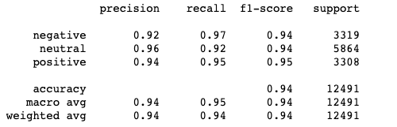



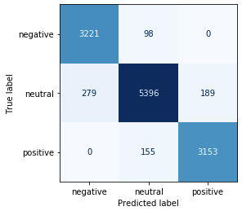
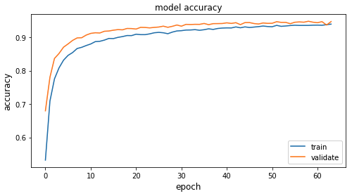
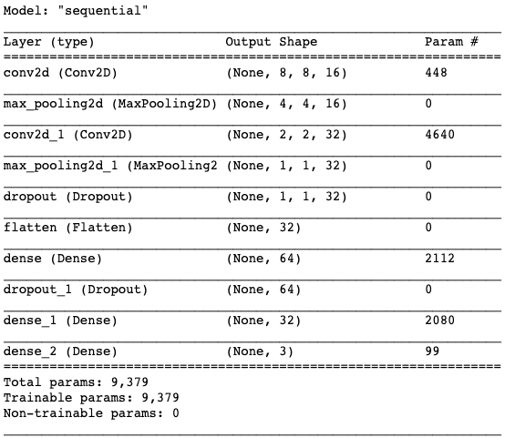
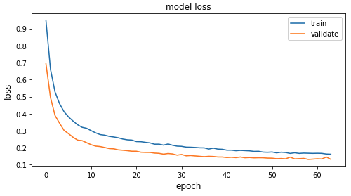
Train & TEST
y_test
y_train
balance

Slide 7
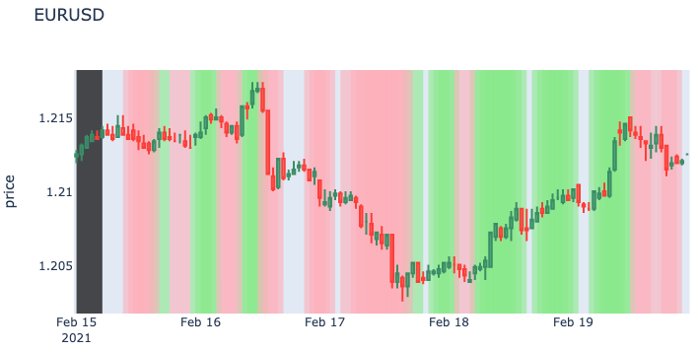
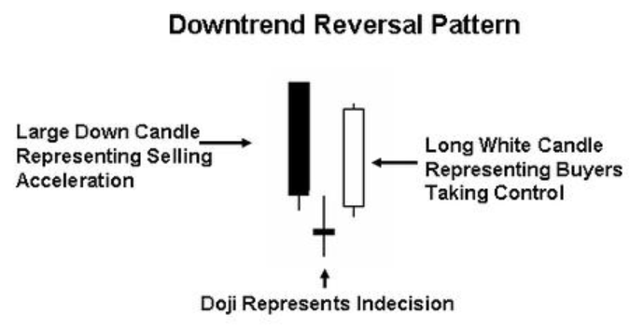
predicT
Positive/negative slopes often occur at inflection points.
Potential use → as first step in identifying Candlestick patterns.
https://en.wikipedia.org/wiki/Morning_star_(candlestick_pattern)

Slide 8
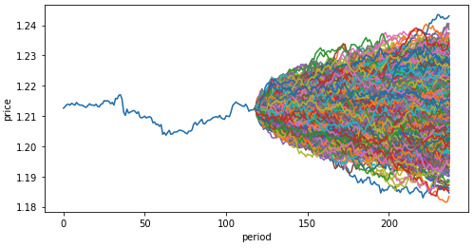
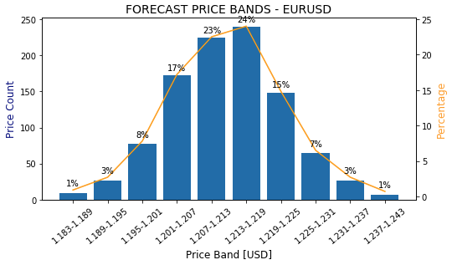
JUST for fun

Slide 9
discussion
CNNs for simple tasks are easily created on a small laptop computer.
Human brains have ~86 billion neurons.
CNN in this project has ~150 x 3 filters (neurons?).
In my opinion Penrose is (still) correct.

